Slide 1

Dynamic Pricing: Optimized Pricing Strategy Using Multi-Armed Bandit theory
Master’s Capstone Project Mohammed Nihil Puthiya Kottal

Slide 2
Agenda
Introduction
Assumptions
Methodology
Key Findings
Conclusion

Slide 3
Introduction
Dynamic Pricing under Uncertainty:
In real-world settings, customer demand is often unknown and price-sensitive
Frequent price changes are operationally impractical (due to customer trust, market consistency and logistics)
Objective:
Learn demand behavior with limited price experimentation
Optimize pricing decisions to maximize revenue
Minimize regret compared to an ideal seller with full knowledge of demand

Slide 4
Key Assumptions
Finite Demand Hypothesis Space
No Inventory Constraints
Limited Number of Price Changes
Price change limited to 70%-105% of the Cost Price
Independent Sales Outcome

Slide 5
Methodology
Data Collection: ContosoRetailDW sample database, contains real-world-like transactions, promotions, pricing and sales volumes across 2516 products
Product Segmentation: Computed product-level features Average Price, Price Volatility, Total sales Volume and then applied k-means clustering
Demand Function Estimation: for each Cluster-Promotion pair, built demand-price relationships using Ridge Regression and Arimax
Price Simulation: Modelled as a Multi-Armed Bandit problem with limited exploration and fixed price exploitation
Regret Evaluation: Computed the optimal hindsight revenue and evaluated the difference with the actual revenue

Slide 6
Process Flow
Product Segmentation
Transactions
Data Preprocessing
MAB Theorem
Optimal Revenue & Regret Calculation
Price Simulation - 2
Price Fixation - 2
Demand Function generation - Ridge Regression & Arimax
Price Simulation – 1
Price Fixation - 1

Slide 7

Key Findings

Slide 8
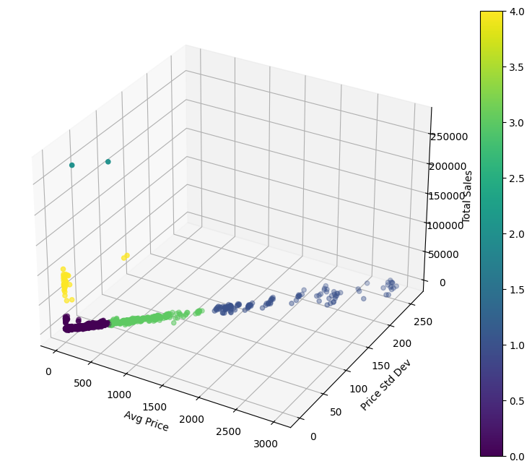
Cluster Output

Slide 9
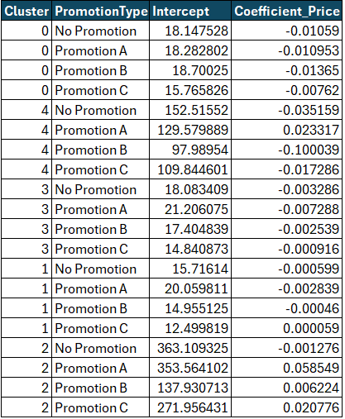
Demand Functions (Ridge Regression)

Slide 10
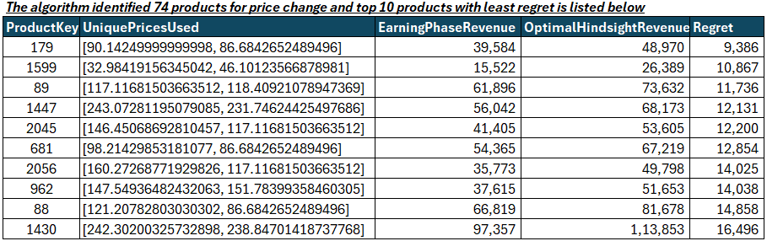
Products Selected for Dynamic Pricing

Slide 11
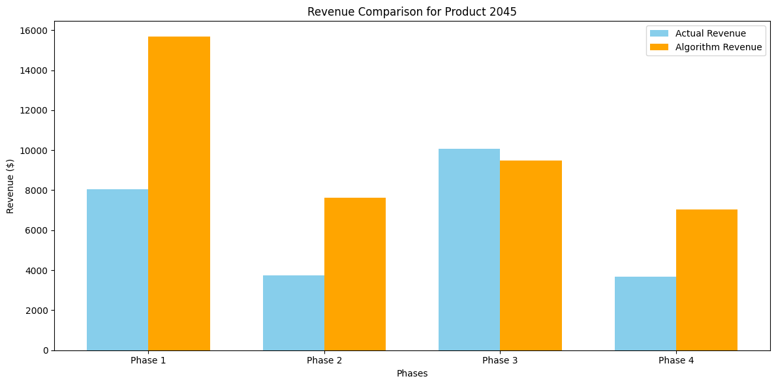
Revenue Comparison

Slide 12
Conclusion
Implemented a dynamic pricing framework based on limited price experimentation, inspired by the m-price-change (mPC) policy from Cheung et al. (2017).
Successfully applied a Multi-Armed Bandit (MAB) approach to balance exploration (learning) and exploitation (earning) under practical constraints.
Built cluster-specific demand models and simulated pricing strategies using real-world-like data from ContosoRetailDW.
Results demonstrate that meaningful pricing decisions can be made with minimal experimentation, achieving near-optimal outcomes with bounded regret.

Slide 13
Thank you!

